Slide 1

Leveraging the Microsoft Graph API using Azure Logic Apps & Functions

Slide 2




Presenters
Abhishek Kumar
Integration Consultant
@abhishekcskumar
https://www.linkedin.com/in/abhishek- kumar-a9776527/
James Corbould
Team Lead &
Integration Consultant
@jamescorbould
https://www.linkedin.com/in/james-corbould-b0073538/
Integration & IoT blog: https://jamescorbould.wordpress.com/

Slide 3
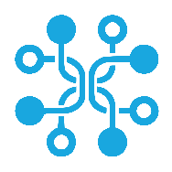
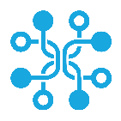
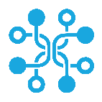

Agenda
Microsoft Graph
Lab Walkthrough
What is a graph 101
What is Microsoft Graph?
Introduction to the Graph API
Graph API delta query and webhooks
Leveraging Graph API using Logic Apps and Functions
Questions?
Level 300 deep dive
Build Logic App to alert on changes to an Excel spreadsheet using a webhook notification

Slide 4
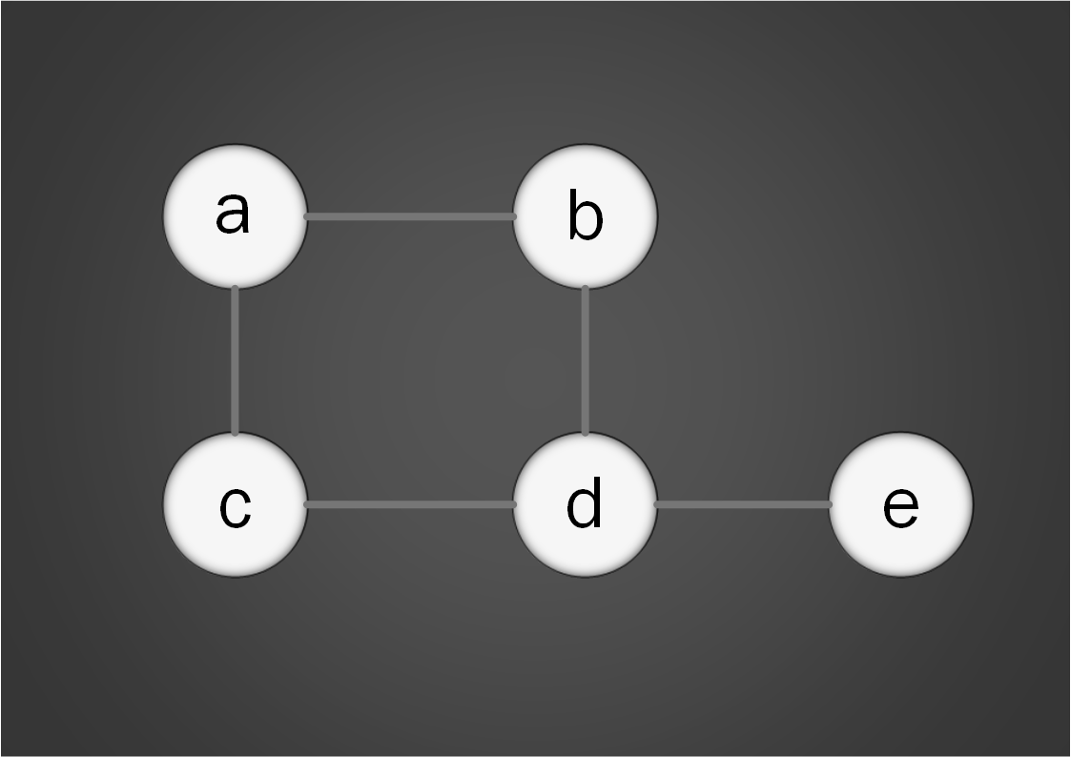
Notes:
Graph theory 101.
Graph is a graphical way of showing objects and representing the relationships between the objects.
Vertices and Edges.
Graphs can be represented in a computer as a data structure or in a database, for example.
It is possible to traverse a graph to identify how objects are related to each other.

Slide 5
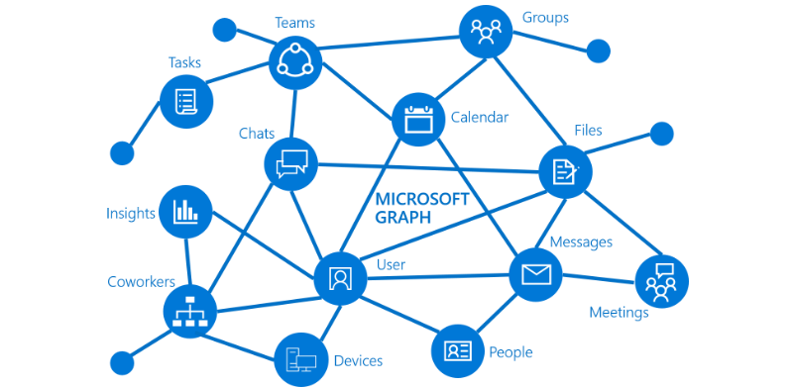
https://graph.microsoft.com
Notes:
Microsoft Graph is made up of resources connected by relationships. It’s a graph database.
Can traverse the relationships between the resources (Abhishek to demo) and perform actions on them using the Graph API, which is a front end interface to the graph.
The complex relationships would be difficult to model in a relational database.
Microsoft is receiving and collecting data from organizations and constantly updating the graph (whether you know it or not!)
Example questions that can be answered using the graph:
Looks at your next meeting and helps you prepare for it by providing profile information for attendees, including their job titles and who they work with, as well as information on the latest documents and projects they're working on.
→ demonstrate traversing the graph to obtain this data/insight, specific to the context of the meeting (e.g. based on the attendees).
Subscribe to changes in your calendar and send you an alert when the meeting has overrun or has been modified, so you don’t have to monitor your inbox.
Delta query – what has changed since my last requrest

Slide 6
Introduction to the Graph API
Notes:
Introduction to the Graph API
Graph API is a front end interface/gateway to Microsoft Graph.

Slide 7

https://github.com/Microsoft/api-guidelines/blob/vNext/Guidelines.md
Notes:
API follows Microsoft’s REST API guidelines.
Good read.

Slide 8
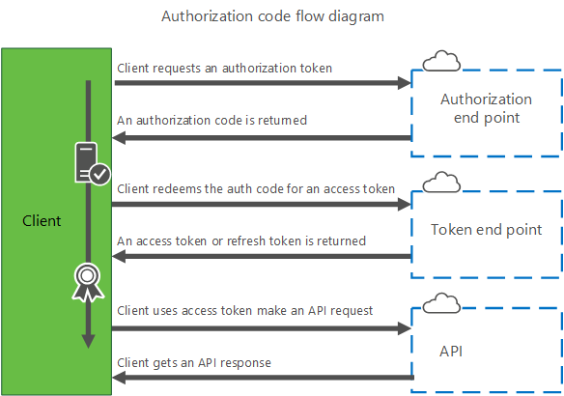
Notes:
Security.
Need to be authenticated and be authorized in order to use the API.
Your app must acquire an access token from AAD cloud identity service using protocols defined in the OAuth 2.0 and OpenID Connect 1.0 specifications.
Authentication
- Can get the user to consent to access.
- Or if no user (apps that run in the background, for example, like a Logic App) then can setup app registration in AAD and assign necessary permissions for users of the app.
- Some permissions require consent from the subscription admin.
With auth token can now request an access token.
Call API with the access token. API can use the token to confirm that the caller has necessary permissions to perform the operation they are requesting.
Always transmit access token over a secure channel – TLS (HTTPS).
Access token transmitted as a Bearer credential in an HTTP Authorization header to the API.

Slide 9
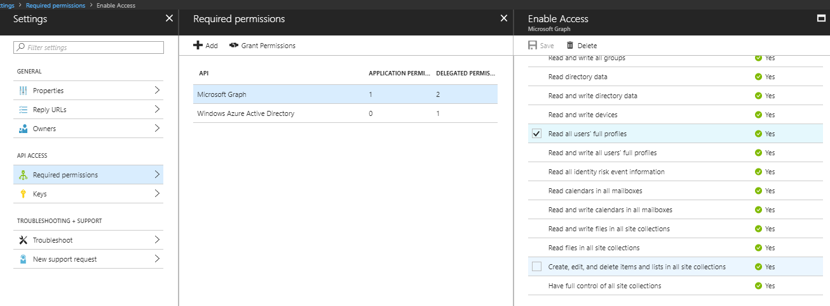
Notes:
App Registration & permissions.
This is for processes where no human user is involved. Can setup an app in AAD and assign permissions.
Some permissions require that the subscription admin click “Grant Permissions” – can sometimes take a few hours for the permissions to be applied, we have found.
Can setup granular permissions to each resource. The access token (JWT) contains encoded information regarding access permissions. For example, different apps can be assigned different permissions, depending on their functionality.

Slide 10
https://graph.microsoft.com/{version}/{resource}?query-parameters
Notes:
Basic usage of the API.
Version:
- V1.0
- Beta – don’t use for Production.
Can query relationships for a resource e.g. me/messages
Can call a function on a resource e.g. me/sendMail
Demo using Graph Explorer tool using O365 account.
- Show how to traverse the graph.
- Query resources, HTTP methods, query relationships.
- Show nextLink if retrieve lots of data in one go and paging is required.
SDKs available.

Slide 11
Graph Explorer Demo (Abhishek)
Notes:
Demo the Graph Explorer tool.
Traverse relationships between resources.

Slide 12
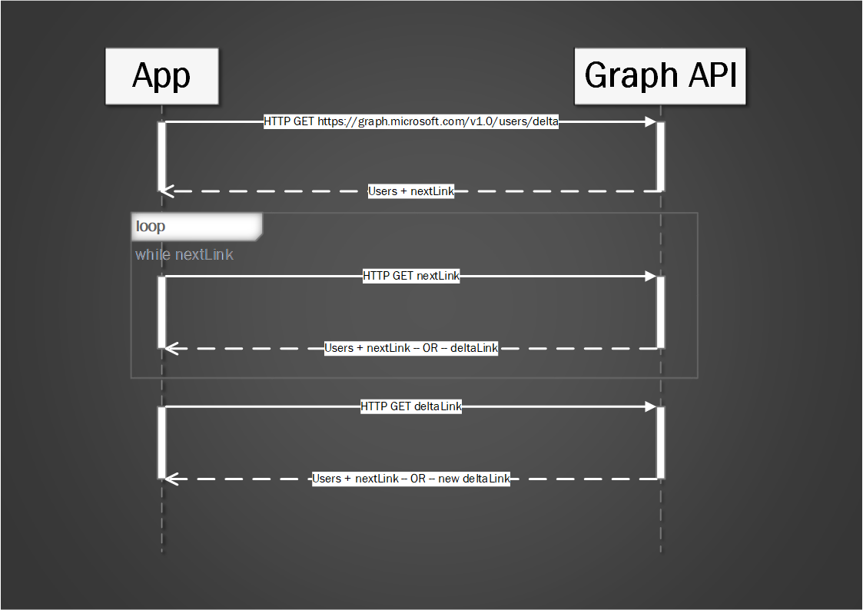
Notes:
Graph API Delta Query. Diagram.
Use to track changes e.g. for triggering other events, updating other systems with the data.
Use delta query to find out changes to entities without having to do a full read each time and work out the differences – resource intensive.
Use delta query to poll on a schedule.
Can use to trigger events in downstream components/systems when there is a change (e.g. using Event Grid), Trigger complex sync jobs etc.
Specify the delta function on your resource.
Do a demo using Graph Explorer on O365 account. JamesC@sunnynz.onmicrosoft.com
Do a demo using my account.
Demo using nextLink until get deltaLink.
Then do a PATCH on my account (change Job Title).
Call deltaLink and should then get my account that has changed
Might need to setup other accounts in O365 sub.
Can use to efficiently sync data with another data store or trigger other actions when a resource changes.
Have to poll periodically using the delta query/token to see if any changes since last poll.

Slide 13
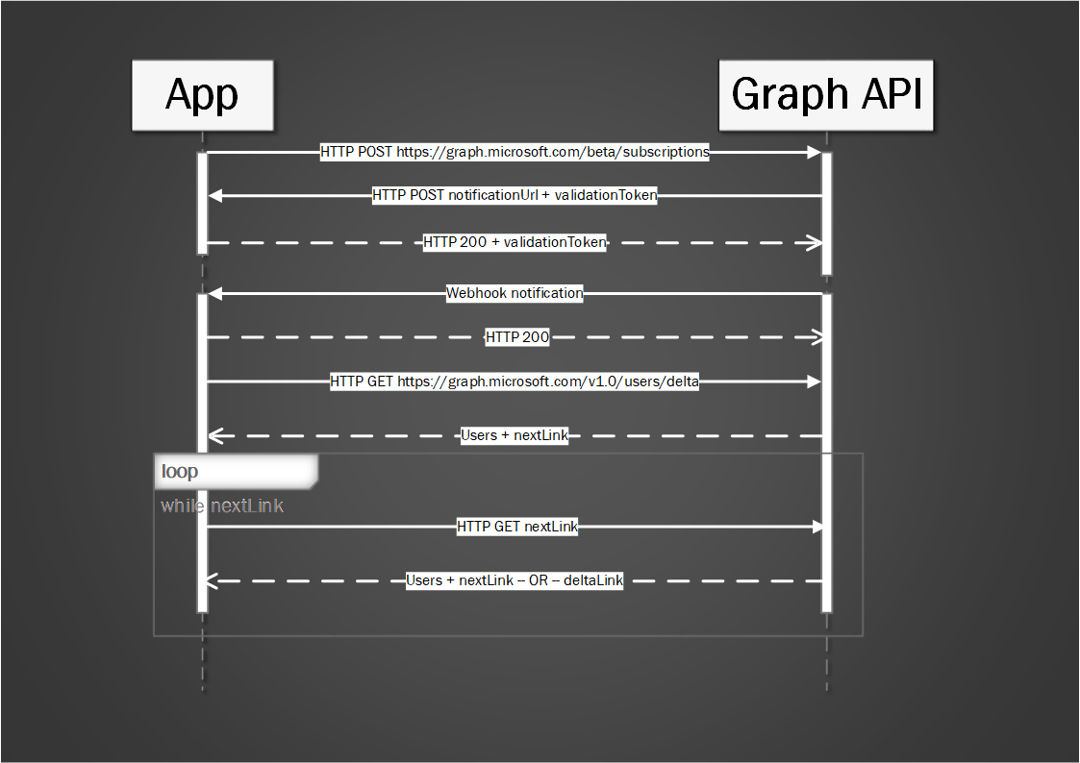
Notes:
Delta Query using Webhooks. Webhooks use beta endpoint.
Would suit an event driven architecture.
Apps subscribe to push notifications to let them know when data has been updated in MS Graph.
Subscription needs to be renewed regularly or will expire, after which no more notifications will be sent (in our demo, we are renewing the subscription daily).
In the subscription message, need to specify the notification URL where the notification will be pushed too (URL endpoint will be a Logic App endpoint in our case).
Lightweight notifications – no data included.
Let’s you know to come and get data, but doesn’t include any data.
Therefore don’t have to poll for changes.
Is a Beta endpoint – so not Production ready yet.
When call the subscription endpoint, MS Graph will confirm that the notification endpoint specified is alive by calling the URL with a validation token.
Only if a response is returned HTTP 200 + return validation token, will the Webhook be established.
When a notification is received, need to loop through the data using nextLink to get all the pages of data until a deltaLink is available – then all the data has been processed.
On first call, will receive all changes and then subsequent calls will just contain the changes.

Slide 14
Lab Demo (James)
Notes:
Demo solution.
Subscribing to changes to an excel spreadsheet in OneDrive by triggering alert to interested parties.

Slide 15
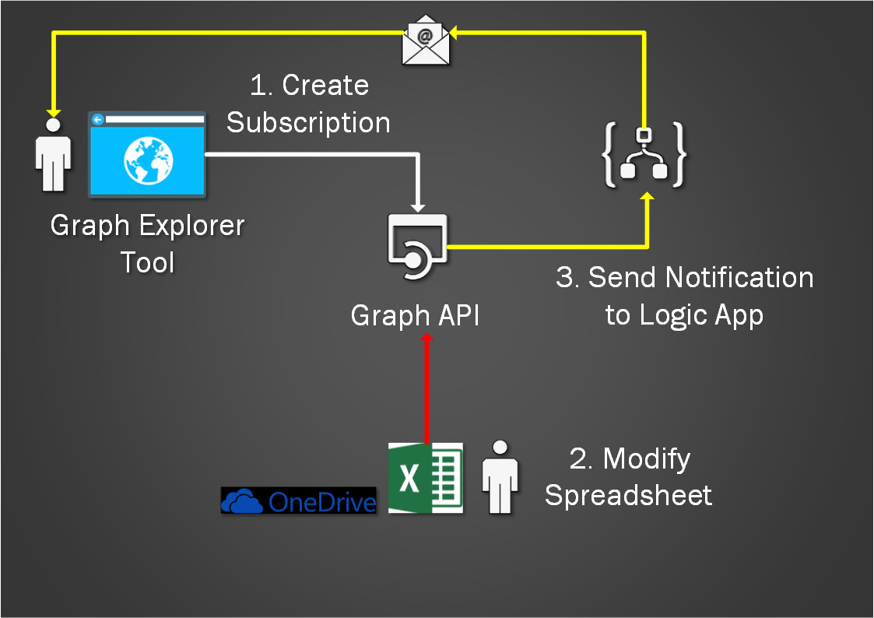
Notes:
Diagram of the solution.
Explain each component and details of the solution.
If you do the lab, this is what you will build.

Slide 16


Reference material
Microsoft Graph official page:
https://developer.microsoft.com/en-us/graph
Build 2017 Microsoft Graph Delta Query and Webhooks:
https://youtu.be/QeHb7w4Z1qs
Delta query overview:
https://developer.microsoft.com/en-us/graph/docs/concepts/delta_query_overview
Microsoft Graph SDKs and samples:
https://github.com/microsoftgraph

Slide 17
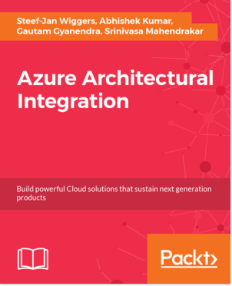
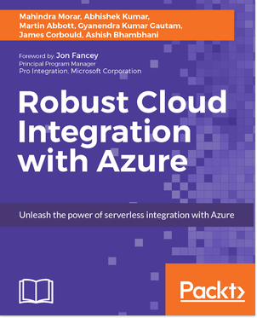
Book discount codes!
These are 40% discount codes valid on ebooks with a validity date of 31/8/2018.
Robust Cloud Integration with Azure : RCIWA40
Azure Architectural Integration : AZAI40

